Slide 1
Struktur Data
GRAPH
SHORTEST-PATH: DIJKSTRA

Slide 2
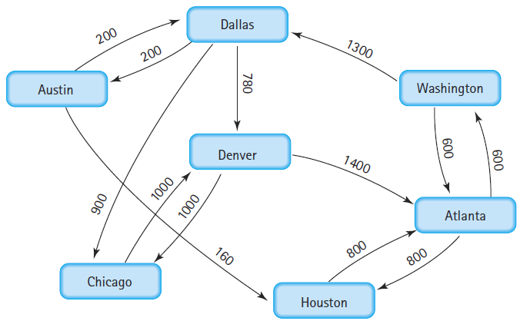
A Weighted Graph
7
ATLANTA
AUSTIN
CHICAGO
DALLAS
DENVER
HOUSTON
WASHINGTON
13
ATLANTA WASHINGTON 600
ATLANTA HOUSTON 800
AUSTIN DALLAS 200
AUSTIN HOUSTON 160
CHICAGO DENVER 1000
DALLAS AUSTIN 200
DALLAS CHICAGO 900
DALLAS DENVER 780
DENVER ATLANTA 1400
DENVER CHICAGO 1000
HOUSTON ATLANTA 800
WASHINGTON ATLANTA 600
WASHINGTON DALLAS 1300

Slide 3
Jarak Terpendek: WASHINGTON CHICAGO
WASHINGTON-DALLAS-CHICAGO: 2200
VERTEX | ATLANTA | AUSTIN | CHICAGO | DALLAS | DENVER | HOUSTON | WASHINGTON
PARENT |  |  |  |  |  |  | WASHINGTON
(0) COST | 999999 | 999999 | 999999 | 999999 | 999999 | 999999 | 0 (1)
PARENT: WASHINGTON | WASHINGTON |  |  | WASHINGTON |  |  | WASHINGTON
(1) COST: 0 | 600 (2) | 999999 | 999999 | 1300 | 999999 | 999999 | 0
PARENT: ATLANTA | WASHINGTON |  |  | WASHINGTON |  | ATLANTA | WASHINGTON
(2) COST: 600 | 600 | 999999 | 999999 | 1300 (3) | 999999 | 1400 | 0
PARENT: DALLAS | WASHINGTON | DALLAS | DALLAS | WASHINGTON | DALLAS | ATLANTA | WASHINGTON
(3) COST: 1300 | 600 | 1500 | 2200 | 1300 | 2080 | 1400 (4) | 0
PARENT: HOUSTON | WASHINGTON | DALLAS | DALLAS | WASHINGTON | DALLAS | ATLANTA | WASHINGTON
(4) COST: 1400 | 600 | 1500 (5) | 2200 | 1300 | 2080 | 1400 | 0
PARENT: AUSTIN | WASHINGTON | DALLAS | DALLAS | WASHINGTON | DALLAS | ATLANTA | WASHINGTON
(5) COST: 1500 | 600 | 1500 | 2200 | 1300 | 2080 (6) | 1400 | 0
PARENT: DENVER | WASHINGTON | DALLAS | DALLAS | WASHINGTON | DALLAS | ATLANTA | WASHINGTON
(6) COST: 2080 | 600 | 1500 | 2200 (7) | 1300 | 2080 | 1400 | 0
PARENT: CHICAGO | WASHINGTON | DALLAS | DALLAS | WASHINGTON | DALLAS | ATLANTA | WASHINGTON
(7) COST: 2200 | 600 | 1500 | 2200 | 1300 | 2080 | 1400 | 0

Slide 4
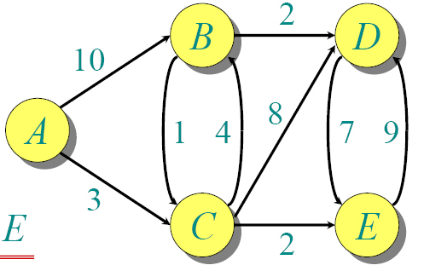
Jarak Terpendek: A
vertex | A | B | C | D | E
PARENT | A
COST | 0 (1) | 999999 | 999999 | 999999 | 999999
PARENT: A (1) | A | A | A
COST: 0 | 0 | 10 | 3 (2) | 999999 | 999999
PARENT: C (2) | A | C | A | C | C
COST: 3 | 0 | 7 | 3 | 11 | 5 (3)
PARENT: E (3) | A | C | A | C | C
COST: 5 | 0 | 7 (4) | 3 | 11 | 5
PARENT: B (4) | A | C | A | B | C
COST: 7 | 0 | 7 | 3 | 9 (5) | 5
PARENT: D (5) | A | C | A | B | C
COST: 9 | 0 | 7 | 3 | 9 | 5
5
A
B
C
D
E
9
A B 10
A C 3
B C 1
B D 2
C B 4
C D 8
C E 2
D E 7
E D 9
Tujuan
Terpendek: A-E?
3 iterasi, A-C-E
Terpendek: A-B?
4 iterasi, A-C-B
Jika mau dicari jalur A-D,
belum yang terpendek
(4 iter) A-C-D = 11
Jika lanjut
(5 iter) A-C-B-D = 9

Slide 5
Algoritma Dijkstra (1)
void dijkstra(graph g, string src1, string dest1){
map<string, string> parent;
map<string, int> cost;
priority_queue<pair<int, string>,
vector<pair<int, string> >,
greater<pair<int, string> > > q;
giter iter;
//inisialisasi
parent[src1] = src1;
cost[src1] = 0;
q.push(make_pair(cost[src1],src1));
string src2, dest2;
int w1, w2;
//dijkstra
string path, temp;
path = temp = dest1;
//cetak jalur terpendek
cout << path << ": " << cost[dest1] << endl;
}

Slide 6
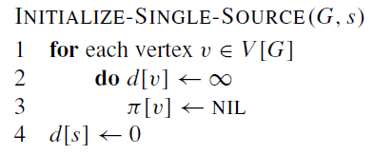
Algoritma Dijkstra (2)
//inisialisasi
for (iter = g.begin(); iter!= g.end(); iter++){
parent[iter->first] = "";
cost[iter->first] = 2000000;
}
[cormen dkk, 2009] Introduction to Algorithms
Thomas H. Cormen, Charles E. Leiserson, Ronald L. Rivest, and Clifford Stein.
The MIT Press, 3 edition, (2009)
//cetak jalur terpendek
while(temp != src1){
temp = parent[temp];
path = temp + "-" + path;
}

Slide 7
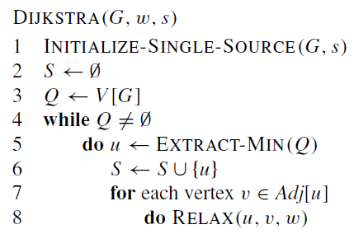
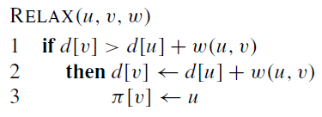
Algoritma Dijkstra (3)
//dijkstra
while(!q.empty()){
w1 = q.top().first;
src2 = q.top().second;
q.pop();
if(src2==dest1) break;
edges temp = g[src2];
for(int k = 0; k < temp.size(); k++){
dest2 = temp[k].first;
w2 = temp[k].second;
if(w1+w2 < cost[dest2]){
parent[dest2] = src2;
cost[dest2] = w1+w2;
q.push(make_pair(cost[dest2],dest2));
}
}
}
[cormen dkk, 2009]

